Slide 1
Eeny, Meeny,
Miney, Sample!

Slide 2
01
About the challenge
02
About the project
03
How it works ?
04
Bibliography and conclusion

Slide 3
Let’s begin

Slide 4

Problems :
Astronauts health
A Big amount of money
rocks scientific value
Living in space is not always safe
Sending an astronaut to the space costs a lot of money
some rocks may not be useful for the scientists,

Slide 5


Needs :
Optimise research’s time
Optimise the materials cost

Slide 6



Solutions :
Send a robot instead of an astronaut
Bring the rock with the maximum scientific value
Choosing rocks based on analyzing tools and machine learning

Slide 7
So let’s discover what our project looks like

Slide 8
The name of our project is ROBLEARNING

Slide 9
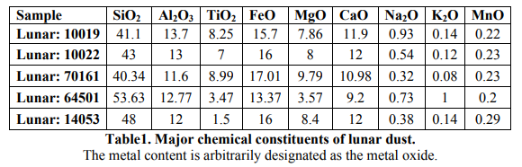
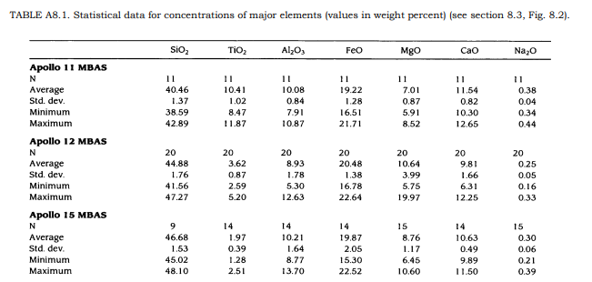

Slide 10
THE PROJECT
CREATING A MACHINE LEARNING SYSTEM
BUILDING A ROBOT
CONNECTING THE TWO SYSTEMS

Slide 11
THE SYSTEM WILL MEMORIZE Coordinates and return the correlation result between the different rocks and the different places

Slide 12
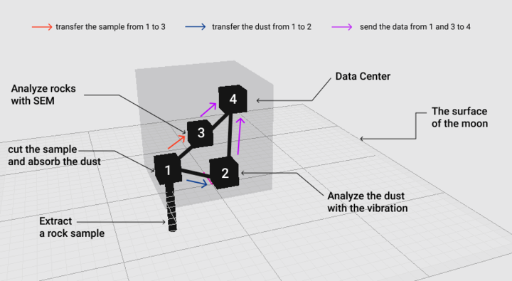
Our Robots in few steps :
SEM : Scanning Electron Microscopy

Slide 13
UX/UI Design

Slide 14
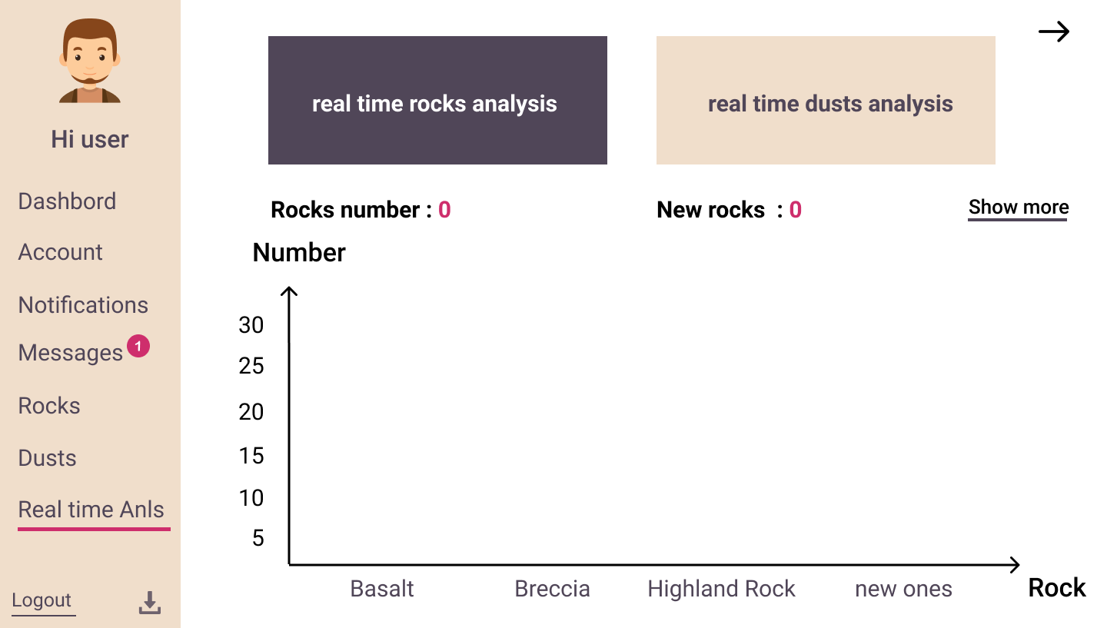

Slide 15
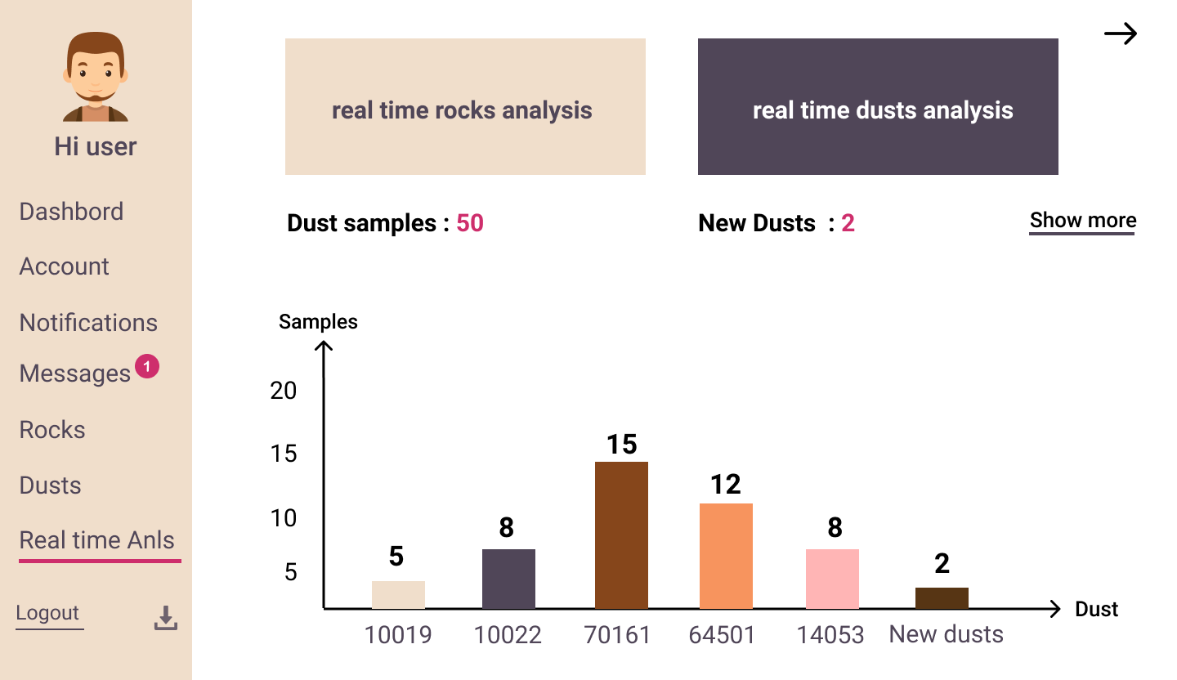

Slide 16
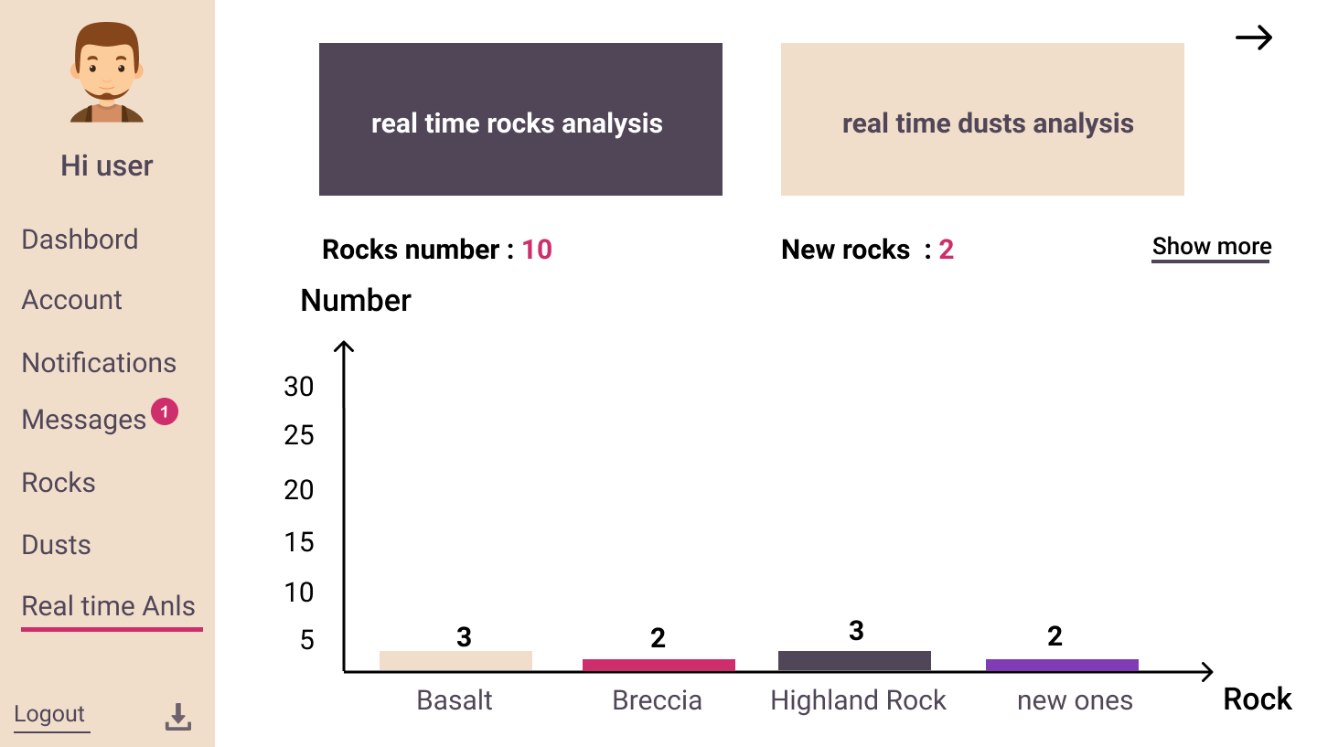

Slide 17
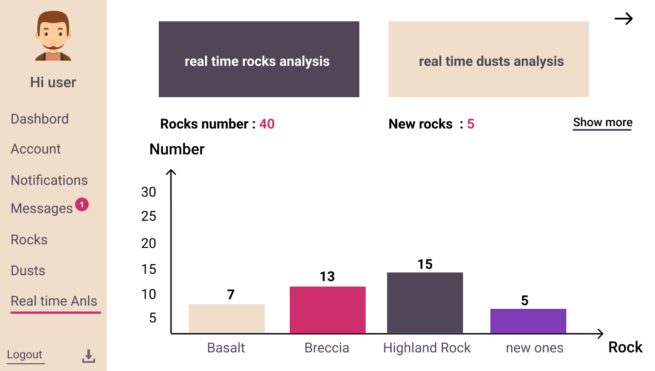

Slide 18
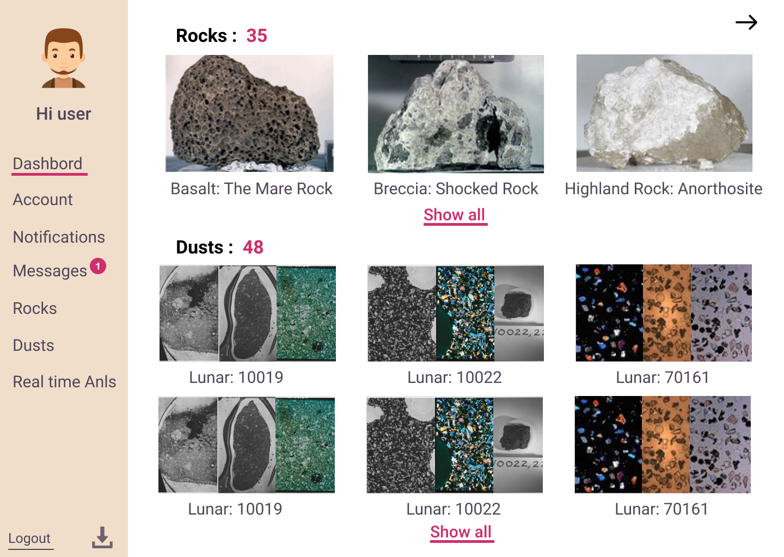

Slide 19
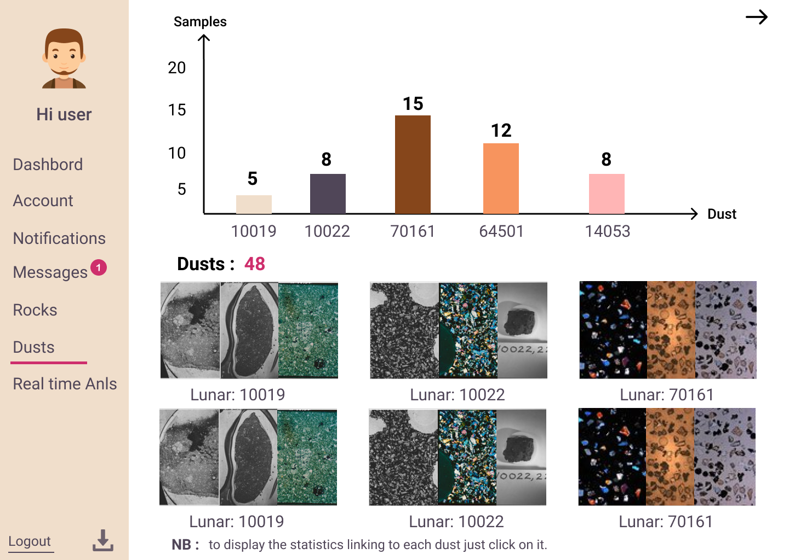

Slide 20
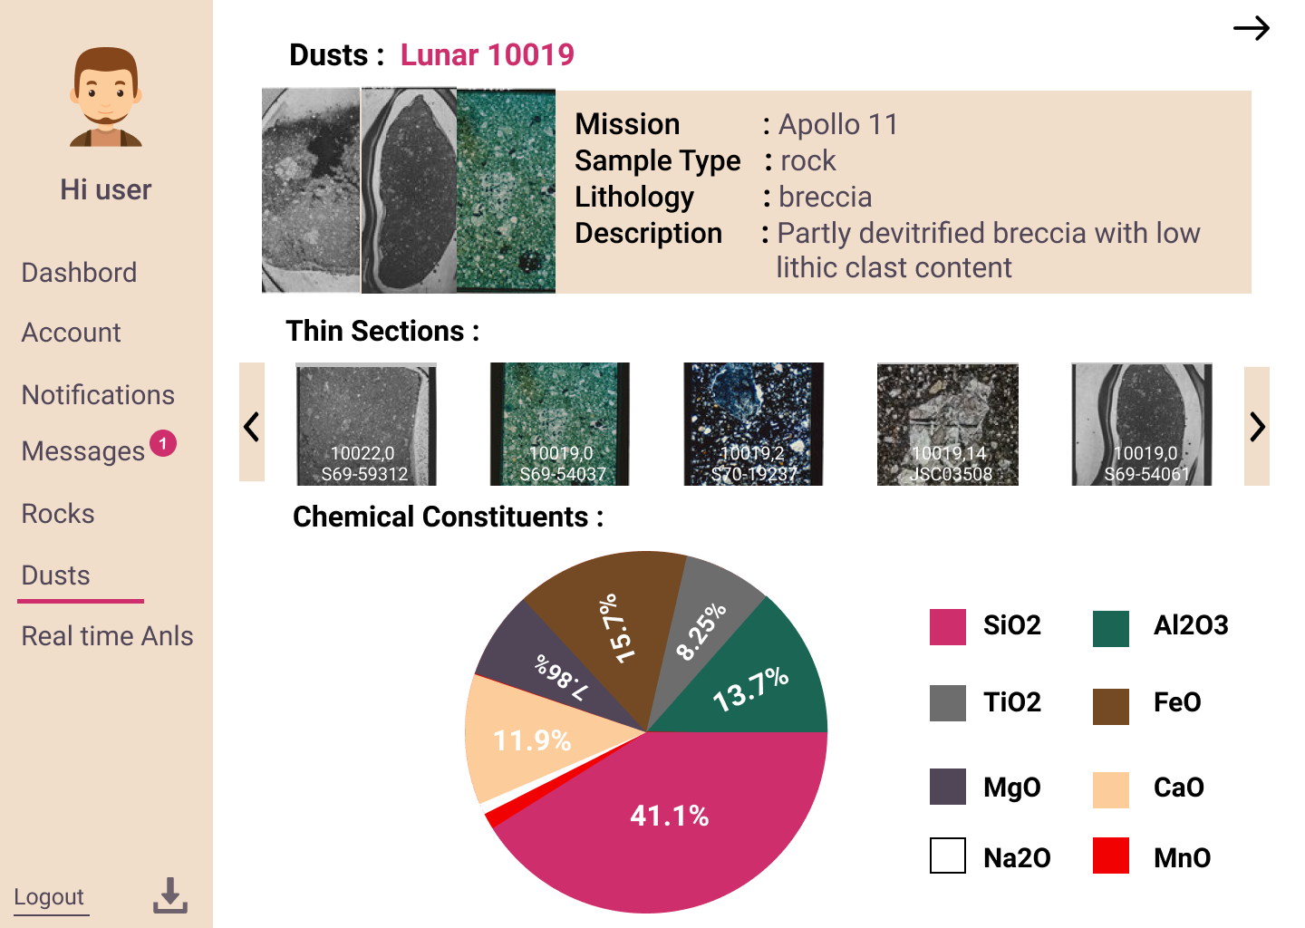

Slide 21
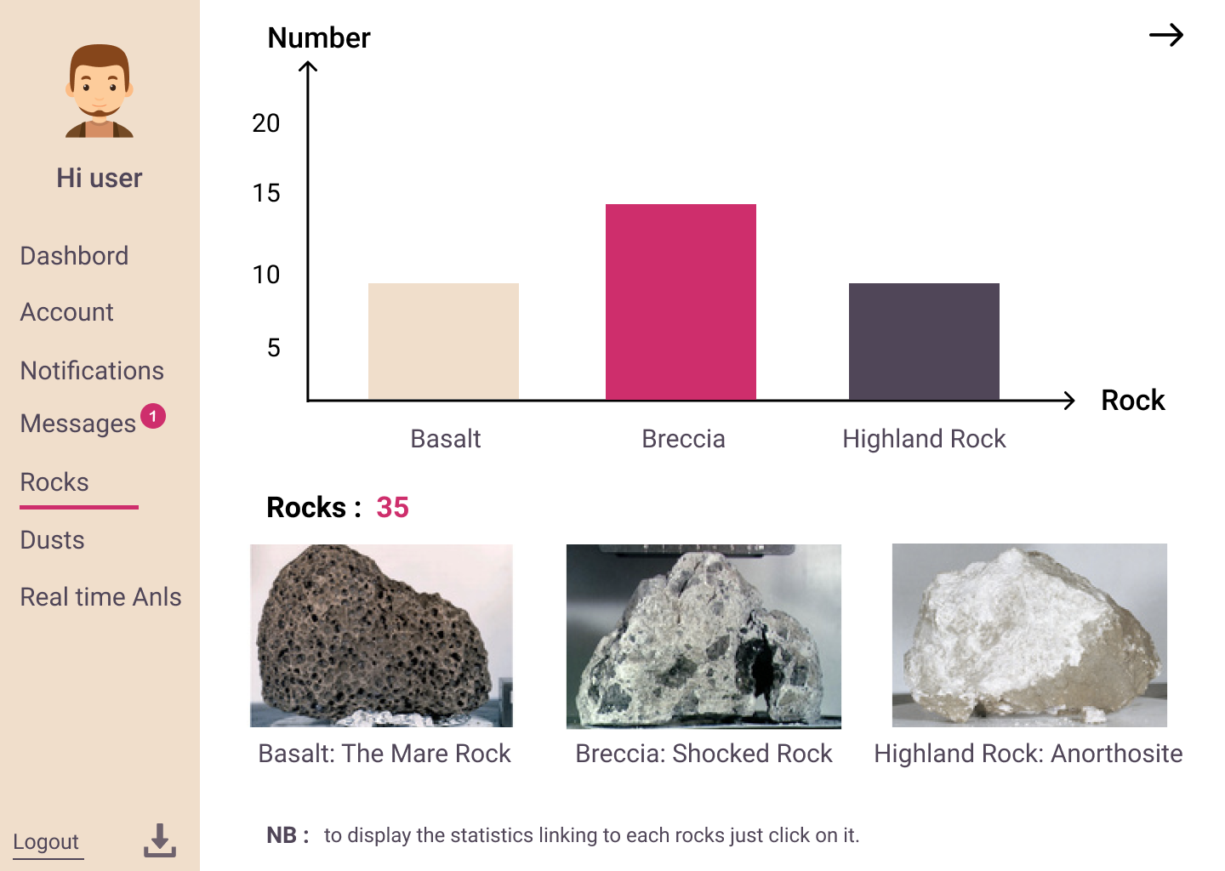

Slide 22
Bibliography
https://www.lpi.usra.edu/decadal/leag/DavidJLoftus.pdf
https://www.lpi.usra.edu/publications/books/lunar_sourcebook/pdf/LunarSourceBook.pdf
https://www.lpi.usra.edu/lunar/missions/apollo/apollo_11/samples/ 11:32 AM
https://www.lpi.usra.edu/lunar/samples/atlas/detail/?mission=Apollo%2017&sample=70161 11:32 AM
https://www.lpi.usra.edu/lunar/samples/atlas/detail/?mission=Apollo%2011&sample=10019

Slide 23
CONCLUSION
Data science tools can provide a better solution to many problems.
optimisation is a must in space exploration, to ensure safety, save money, energy and the most important thing : time

Slide 24
Thank you

